Slide 1
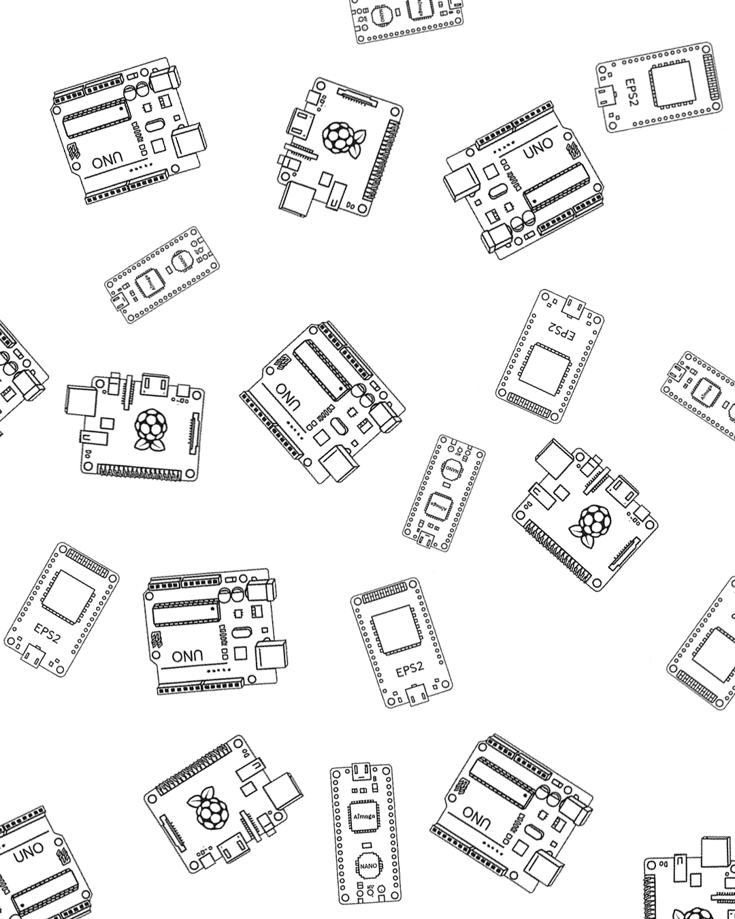
Introduction to Micro-controllers

Slide 2
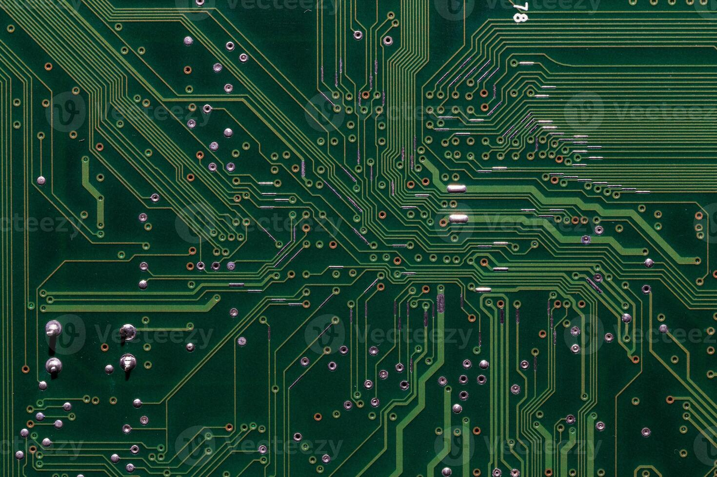
Event Schedule
Presentation on what are microcontrollers
Team up members
Surprise activity
Workshop
Certificates & Pictures

Slide 3
What are Microcontrollers?
A microcontroller is single integrated circuit, that contains essential components like:
CPU
RAM
Flash Memory (Firmware)
I/O interfaces
Built-in timers, ADCs, PWM and etc..
Optimized for low power, reliability, and performing specific control tasks
Designed to operate independently, often without needing a full operating system

Slide 4
Deeper Dive Into GPIO Pins
General Purpose Input & Output
Can read signals coming in through (High or Low) voltage from components
Can output and send signals also using high or low voltage like turning on a led
Some Gpio pins support extra features like:
PWM (Pulse Width Modulation)
Anaolog Inputs
I2C
Etc…
Notes:
Read signals by reading voltage if high or low. If high it might be 3v3 or 5 v, and low is 0 volts
PWM used for dimming lights or controlling motor speeds
Analog is for reading analog components, like dial module
I2C allows you to connect to multiple modules only using 2 wires (SDA and SCL), it works almost like a usb hub, or almost like a switch for ethernet cables but just for gpio pins
Some gpio’s even have feature for touch, where if you touch a pin, it can be triggered just like a button, but that also depends on the type of gpio it is.

Slide 5
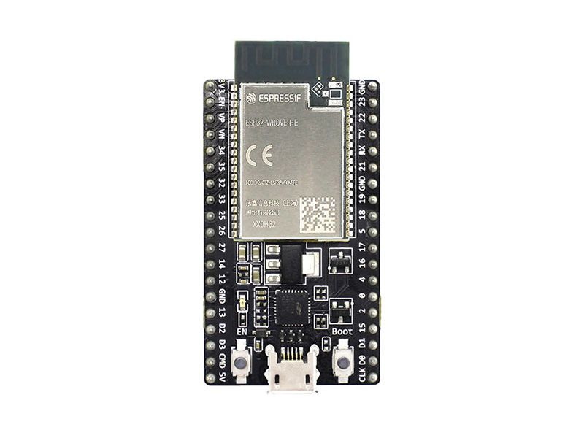
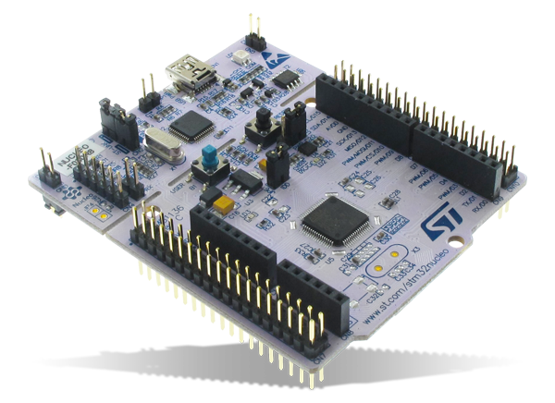
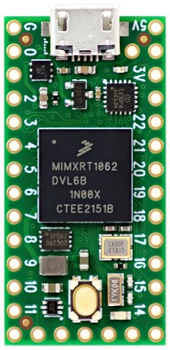
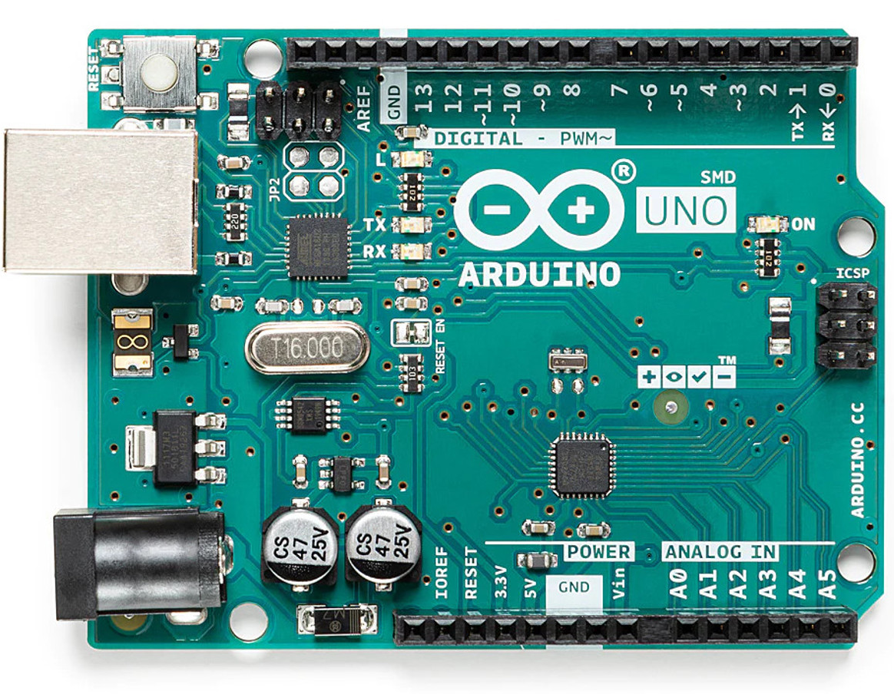
Examples of micro controllers
STM32
ESP 32
Teensy 4.0
Arduino Uno
Notes:
STM32 is the industry standard for microcontroller choice and embedded systems because of its high reliability, real time performance and long product lifecycle support (manufacture will guarantee to keep making it and supporting that chip for many years to come)
ESP32 more useful for iot projects, home smart appliances, and easy for hobbyist and startups because its faster to prototype with

Slide 6
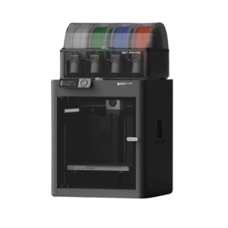
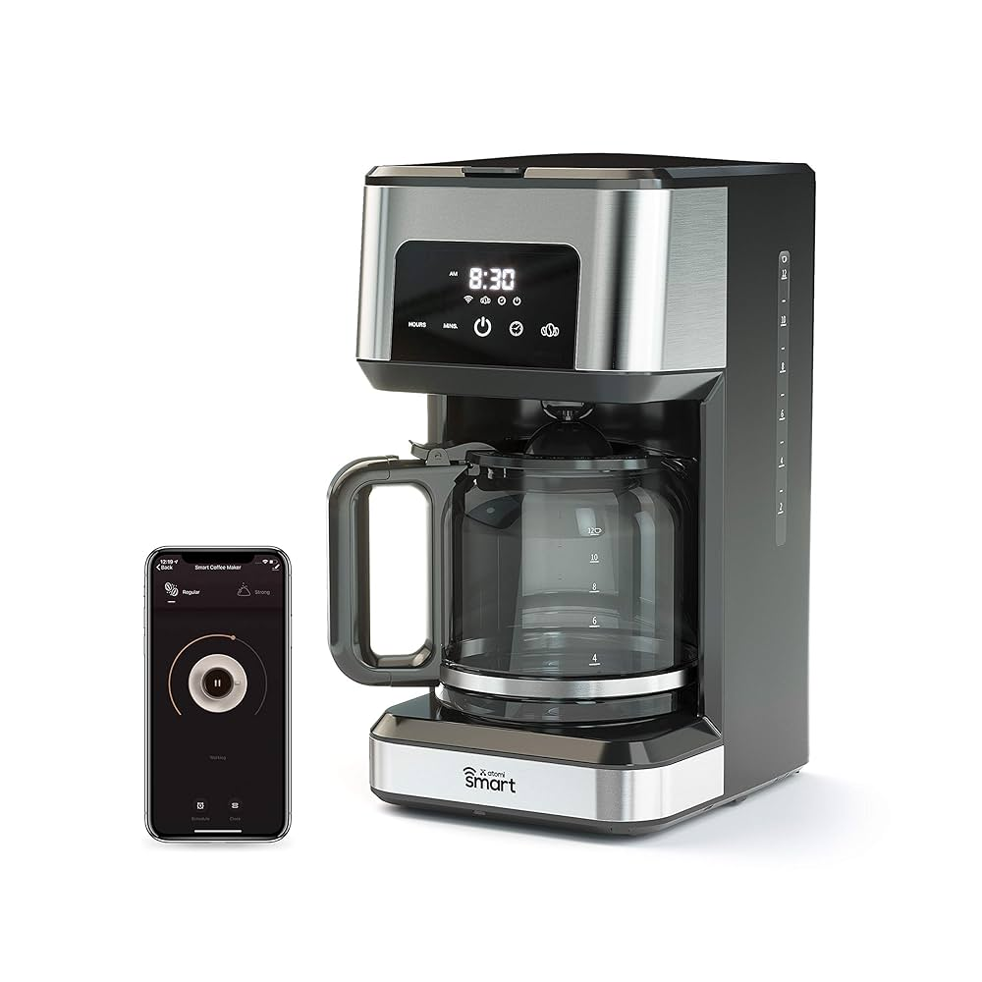
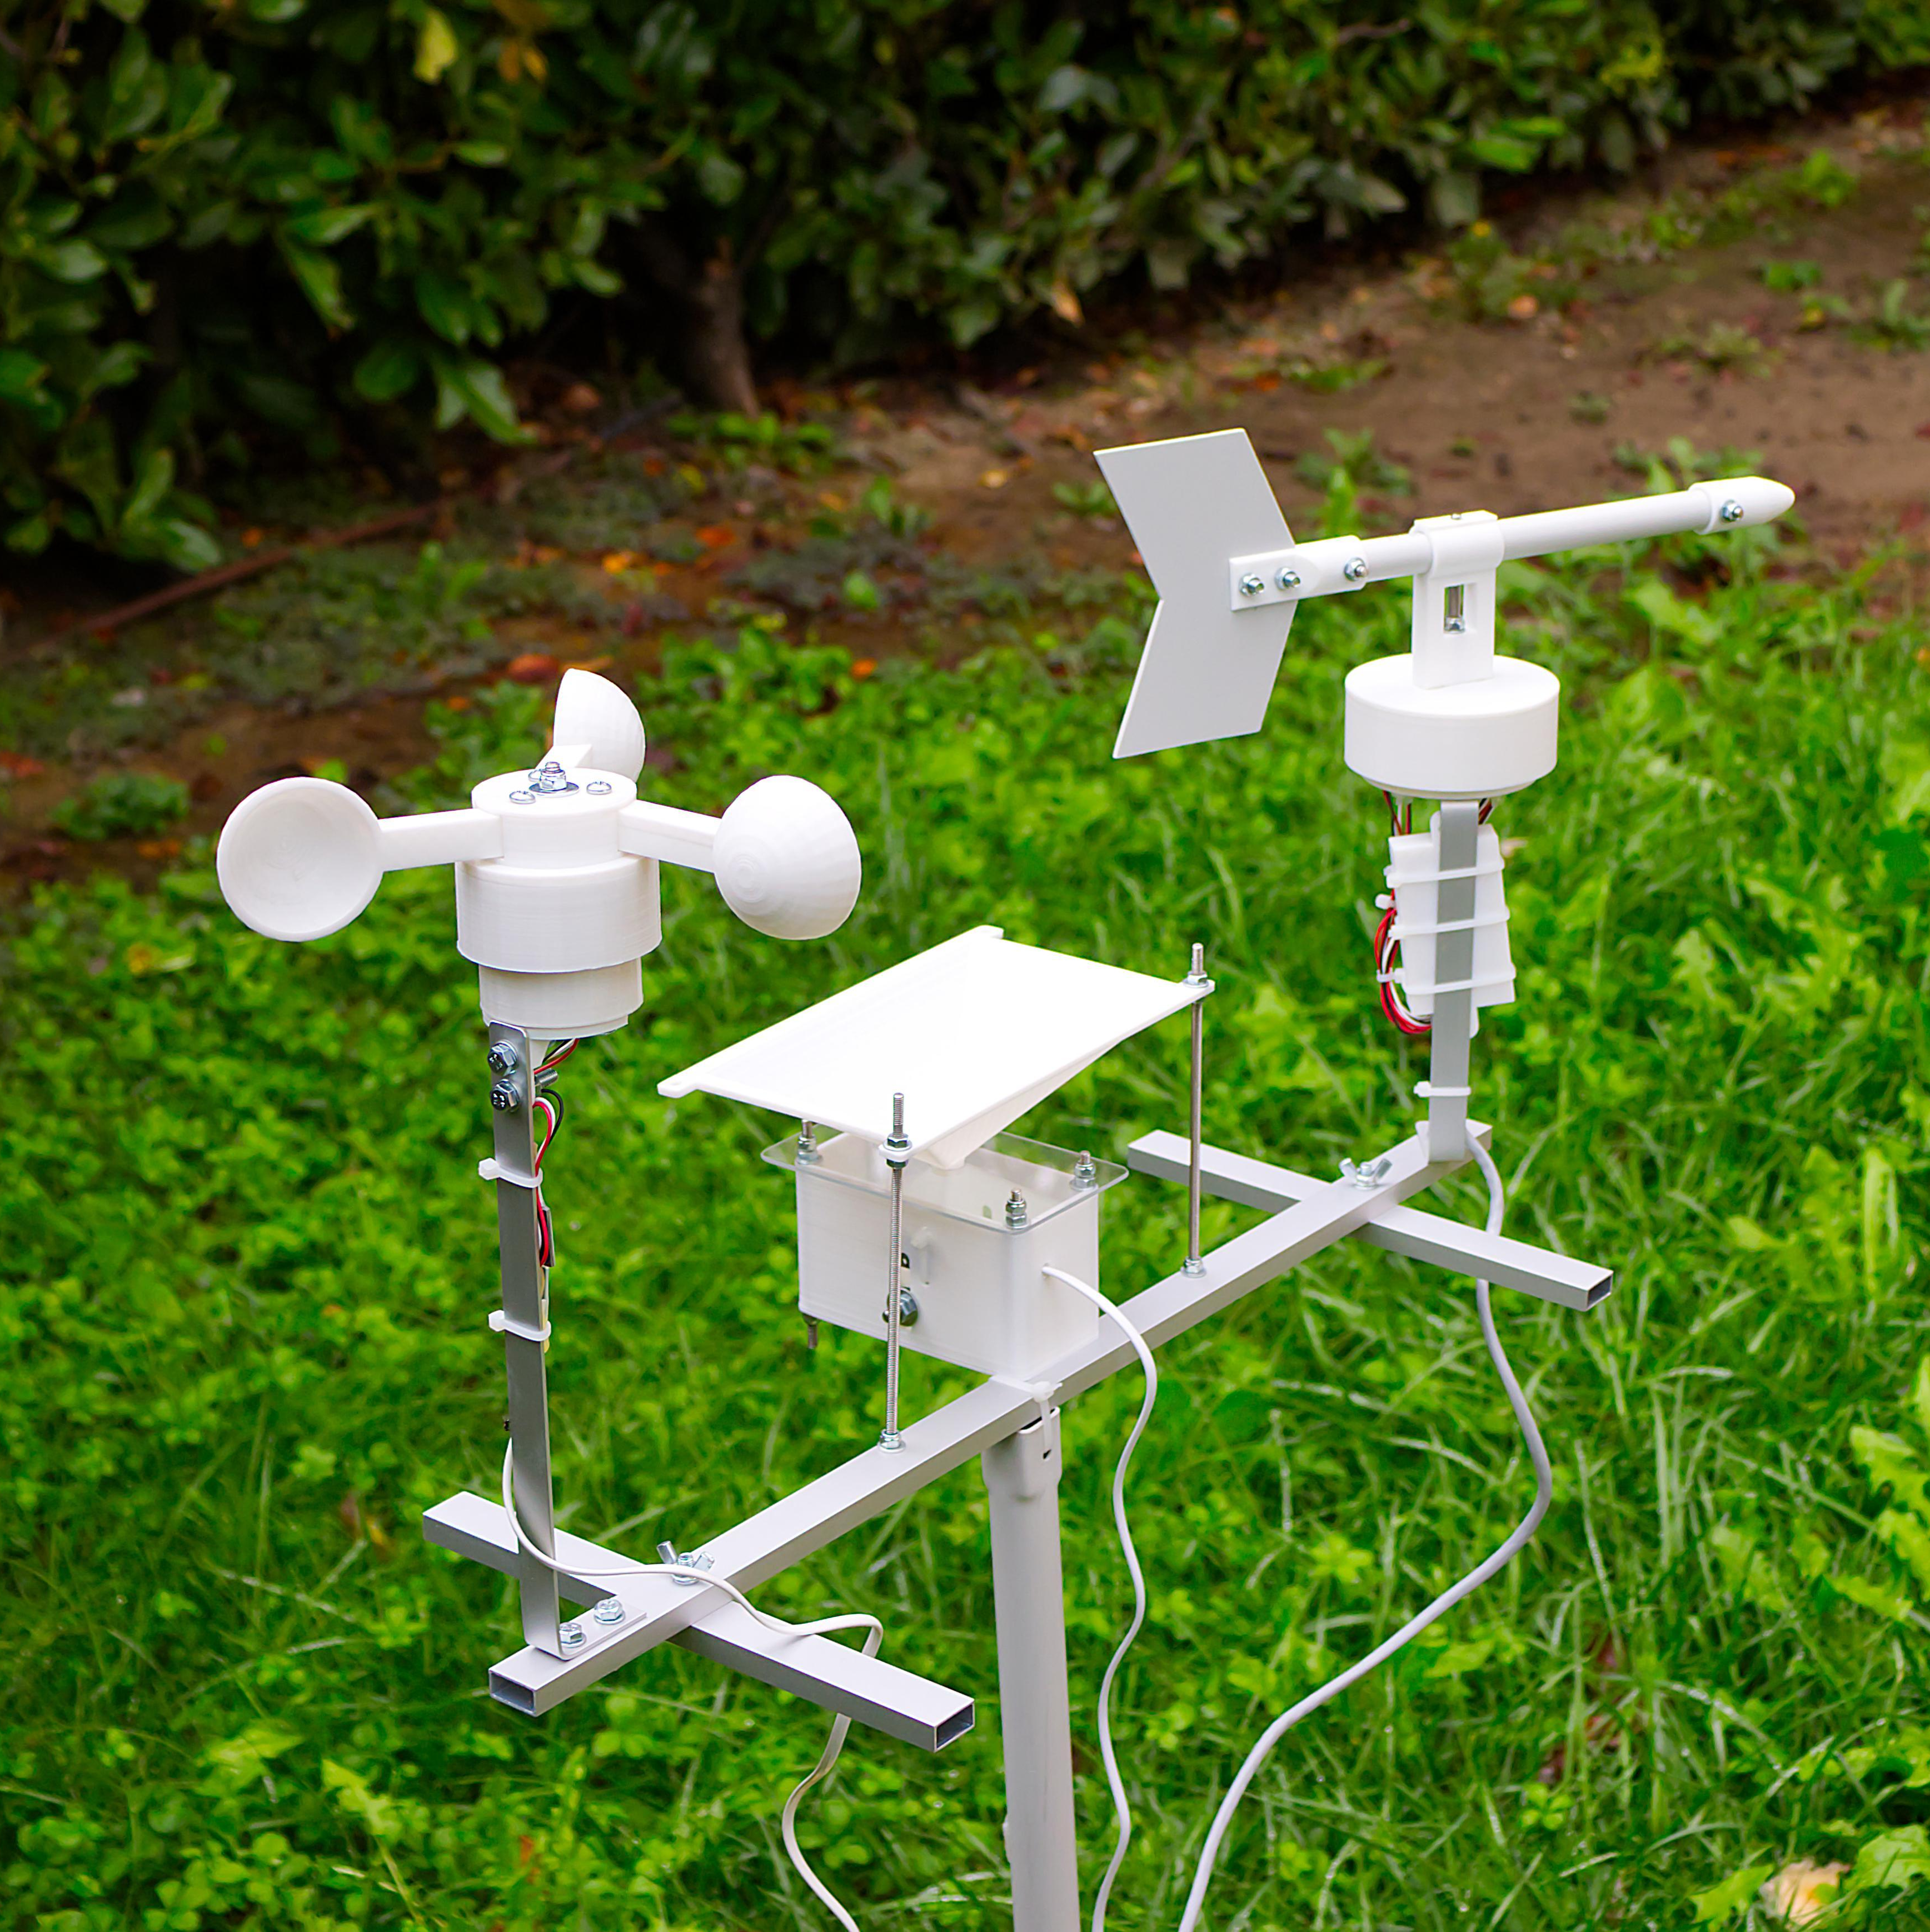
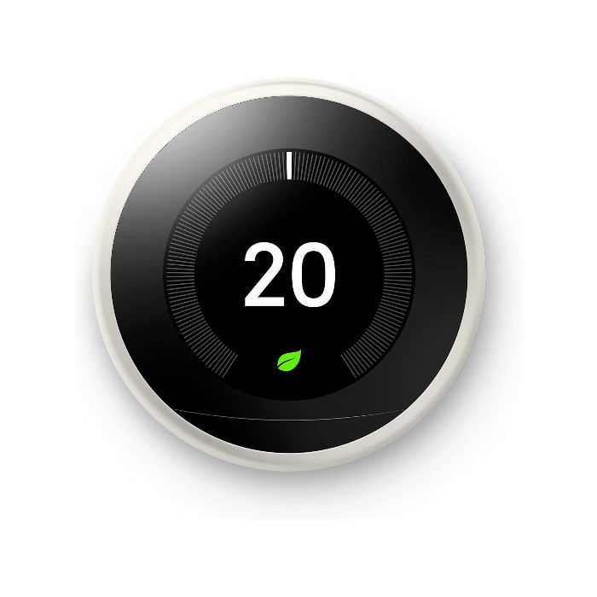
Industries they are used in
Used In:
Robotics
homes smart Appliances
3D Printers
Notes:
-3D printer itself does not use microcontroller, for printing. Although for connecting to wifi, ams system and also showing user status of print, and sending data is handled by esp32

Slide 7
What is a embedded Device
An embedded device is designed to perform one specific function or a small set of tightly related tasks.
Complete system built for one specific function
Includes processor, I/O and supporting hardware
Runs a dedicated software or OS focused on a fixed task
Notes:
An embedded device is a complete system built to perform one specific function, combining both hardware and software tightly integrated for that task.
It includes a processing unit (usually a microcontroller or microprocessor), along with other components like sensors, buttons, displays, or communication modules.
It may run bare-metal firmware, a real-time OS, or even a minimal Linux, but it always boots into a dedicated environment designed for its fixed purpose, not for general computing.

Slide 8
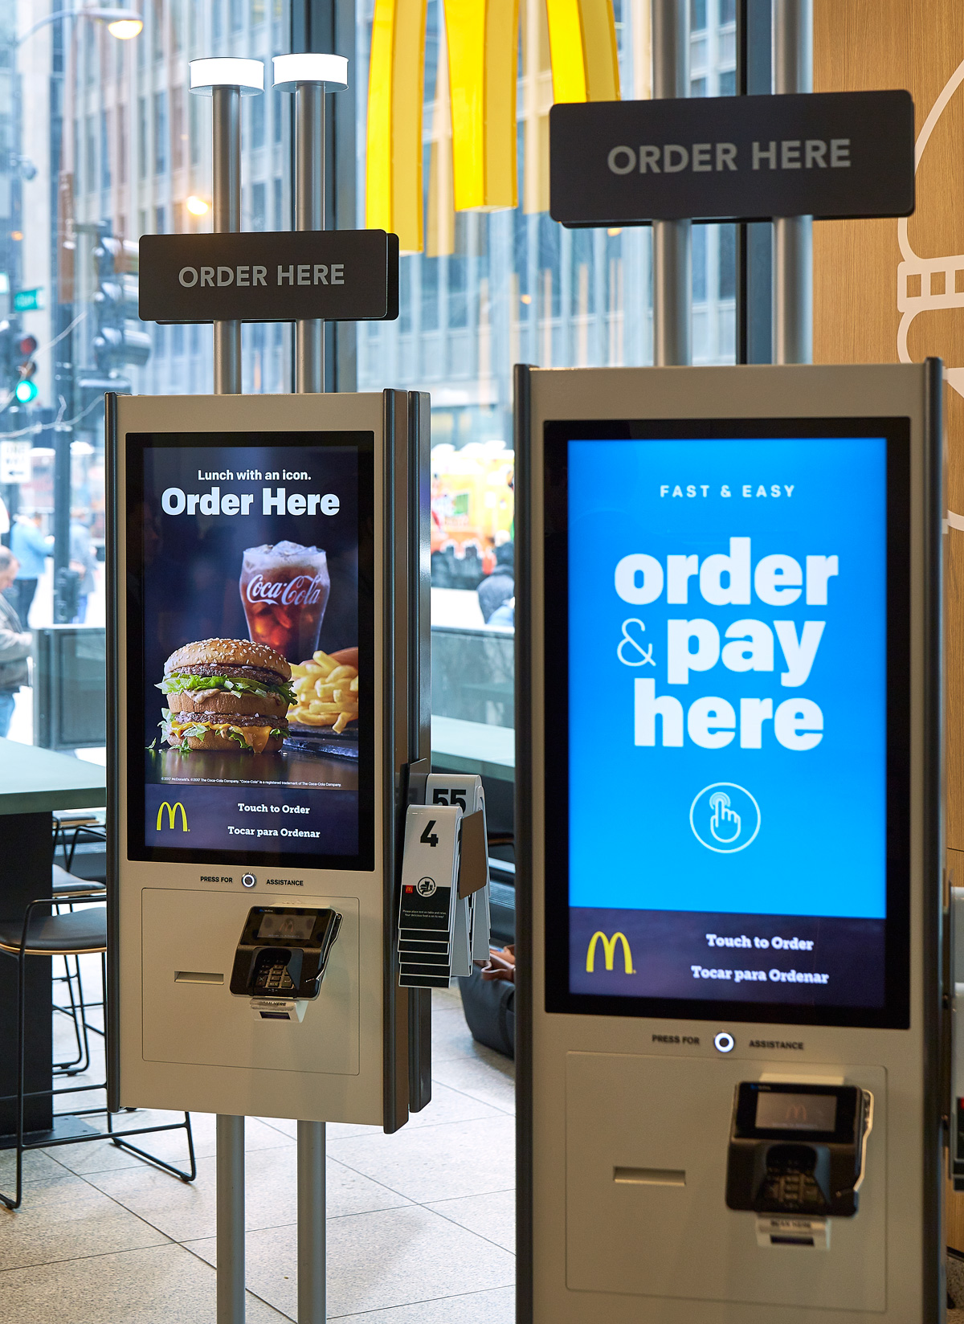
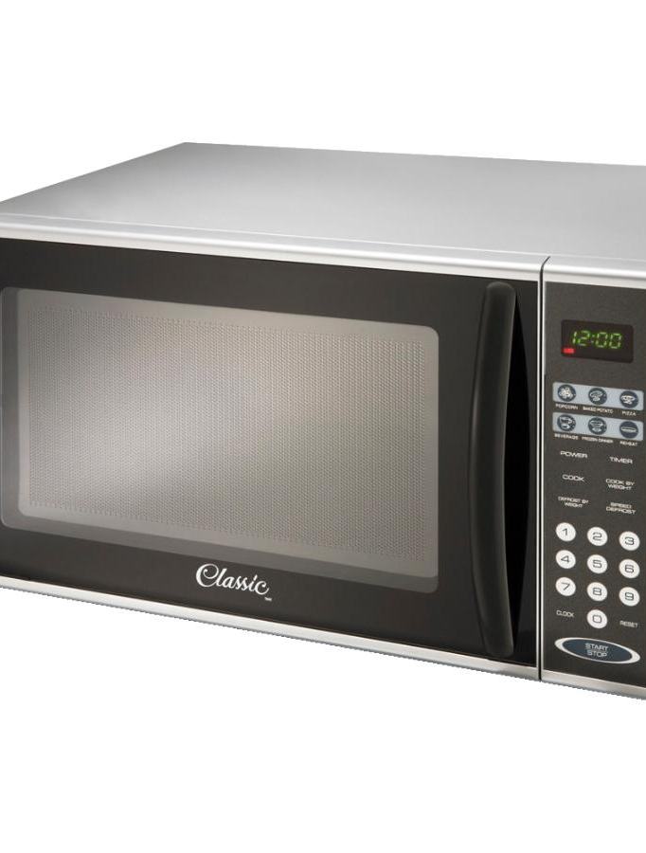
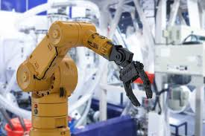
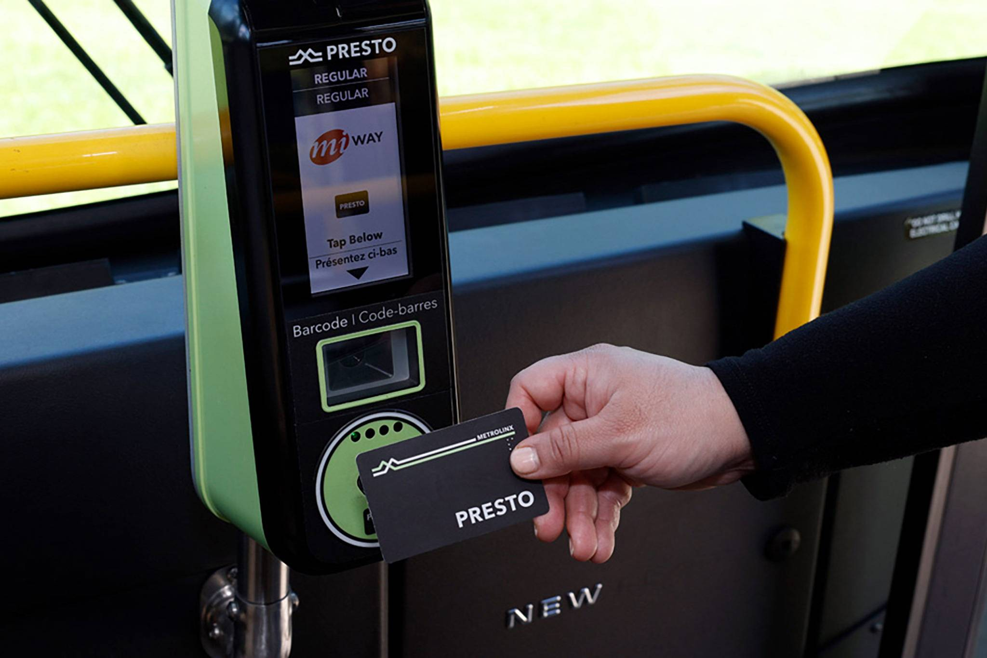
Example of embedded devices

Slide 9
Micro controller vs embedded devices
 | Micro-Controllers | Embedded Devices
Programming | You write and upload the code manually (C/C++, Micro Python, Rust, assembly, etc..) | Often comes pre-programmed or runs specialized software
Flexibility | General-purpose and reprogrammable | Fixed-purpose — hard to repurpose once deployed
Form Factor | A single IC chip | A complete physical system, may include casing and UI
Design Phase Location | Lives in the circuit design phase | Appears in the product assembly or deployment phase
Costs | Very low usually under $5 | Costs can very from a few dollars to hundreds
User access | Directly programmable and customizable | Often closed system, not meant to be modified by the end user

Slide 10
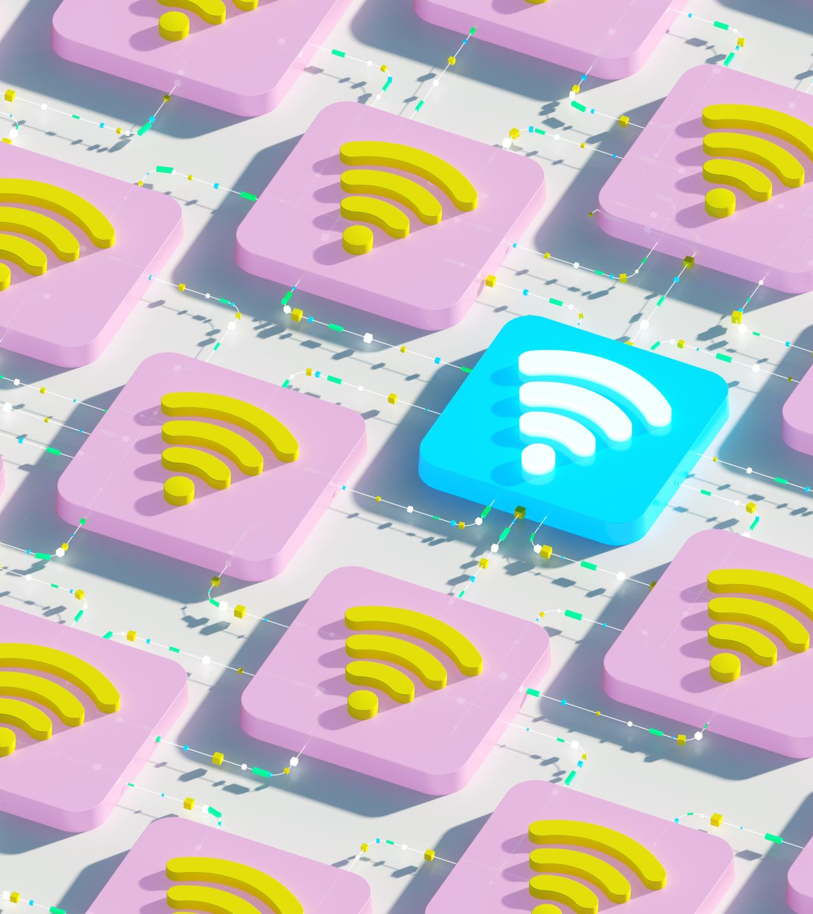
What are iot devices
Microcontrollers / Embedded devices sending data over the internet
Examples:
Weather Station
Smart doorbell camera
Smart home thermostat

Slide 11
Thank you for attention

